Slide 1
`Come On Down To The Water’
Johnson's Creek -- Facebook -- Twitter -- Instagram -- YouTube -- Spotify -- Apple Music

Slide 2
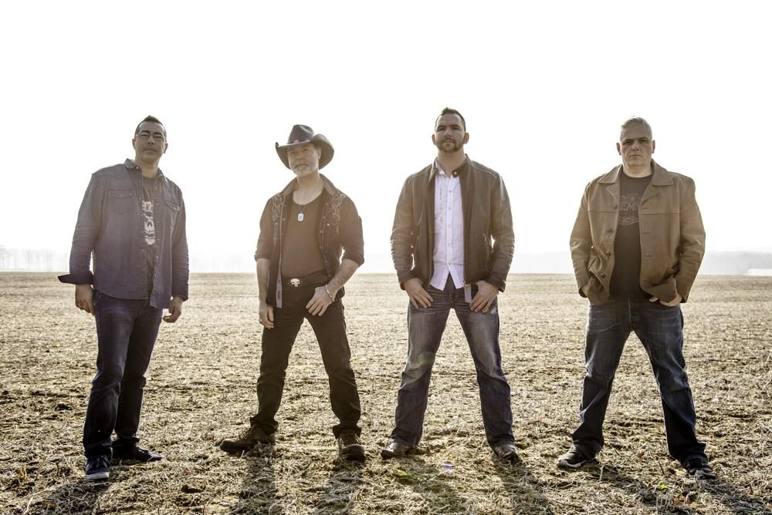

Slide 3
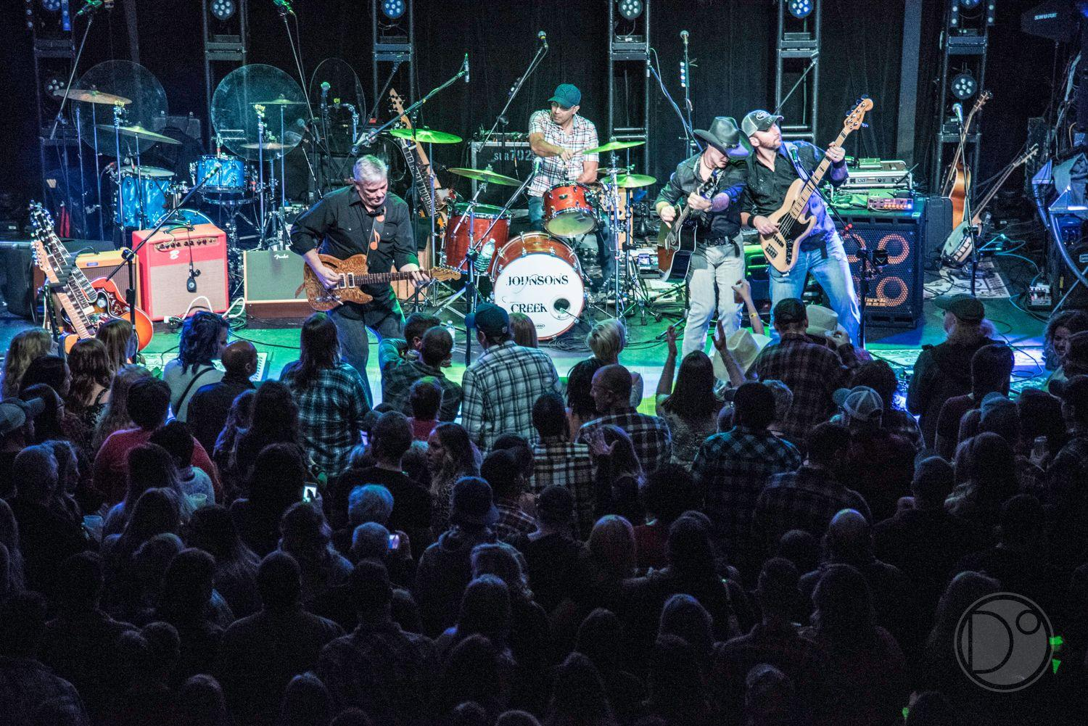

Slide 4
Who Is Johnson’s Creek
- - - - X
Johnson's Creek is a premier country rock band from south-central Ontario. The music is fresh, drawing inspiration from legends like: Cash, Haggard and Williams, mixed with the fun lyrical stylings of The Road Hammers and Blackjack Billy. The music is best described as country rock or "redneck rock n' roll". The guys bring a high energy stage presence and love to get interactive with their audience. Having released their debut single “Ocean Fantasy” in the summer of 2017, the guys have followed that up with another summer time single “I Like It Dirty” in June 2018. The band has just gotten out of the studio and released their debut EP in August 2019.

Slide 5
Memberships
- - - - X

Slide 6
Endorsements
- - - - X
We are happy to include Jojo Cajons to our instrument arsenal. Jojo Cajons are Canadian made (just up the road from us in fact - Barrie, Ontario), and are hand crafted from top materials, and can be custom designed for every need. Rick Carreiro is thrilled include Jojo Cajons in all our performances. They are our preferred percussion instruments, more details can be found here.

Slide 7
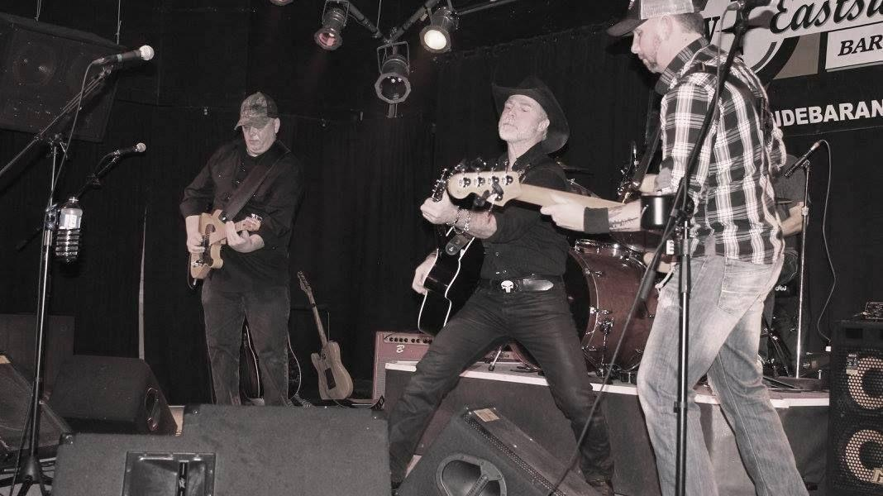
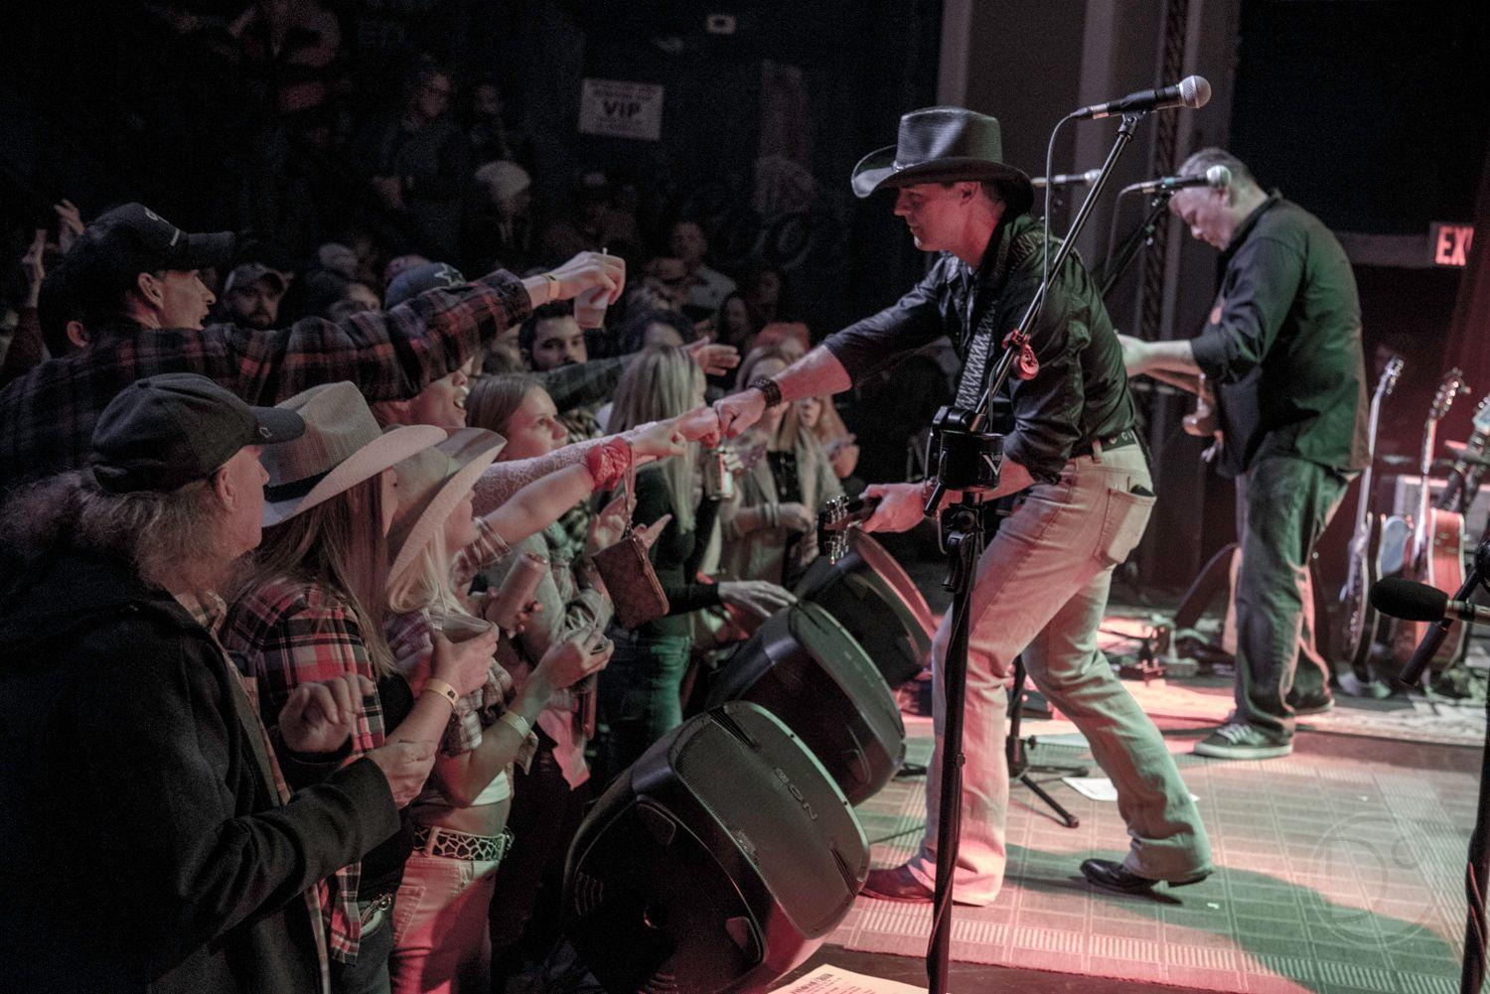

Slide 8
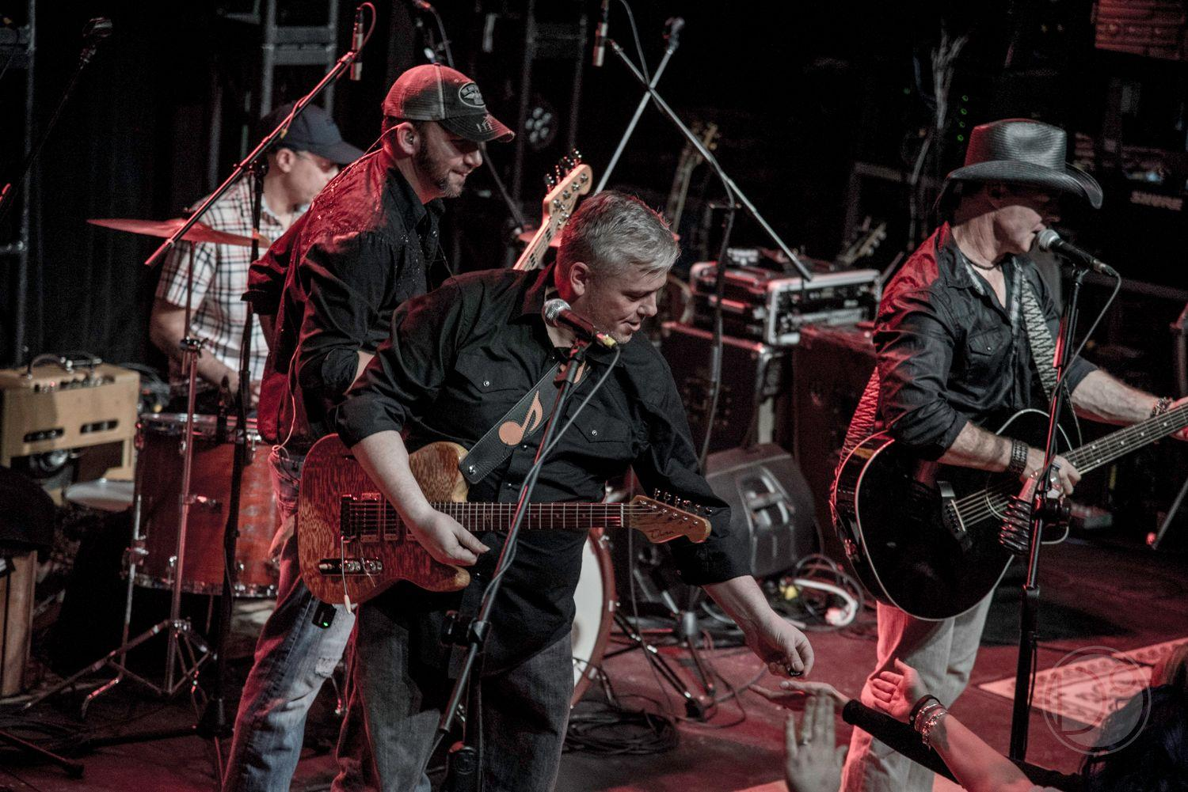
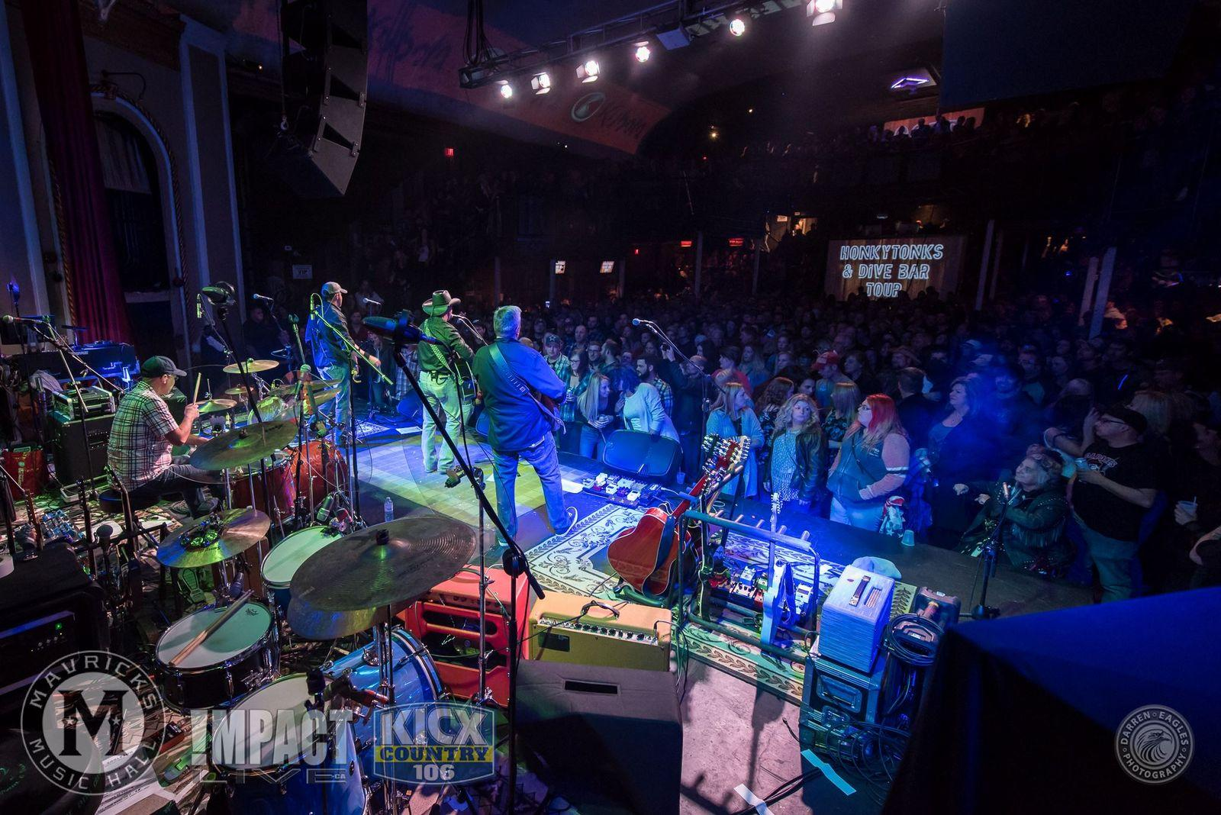
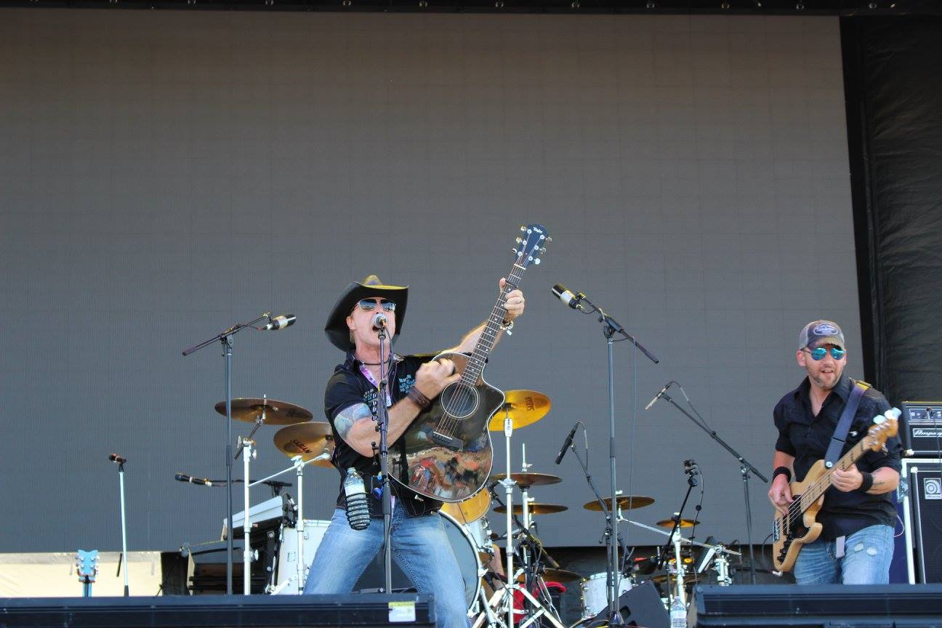

Slide 9
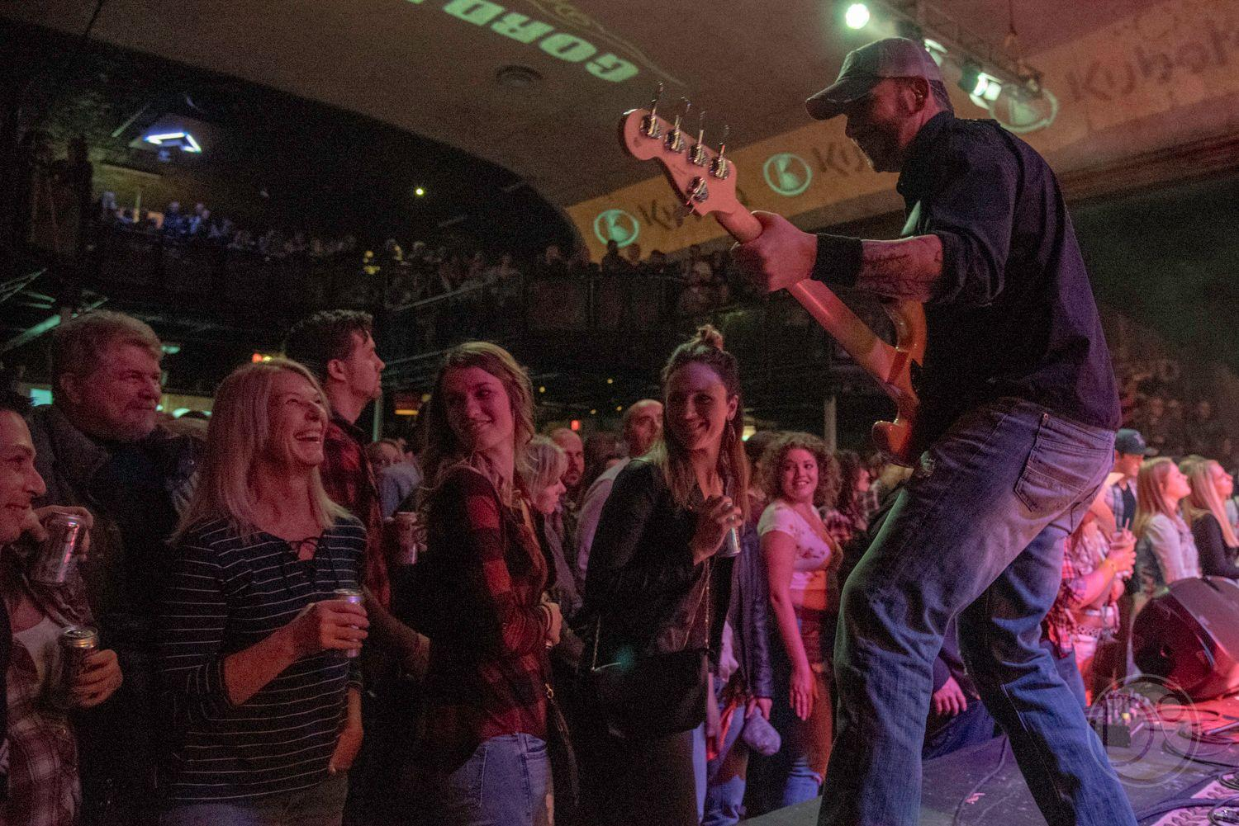

Slide 10
What’s Being Said

Slide 11
“
JOHNSON’S CREEK KICKS OFF NORTHERN TOUR AT STARS AND THUNDER - My Timmins Now -- Article, John Emms
A COUNTRY NEW YEARS EVE IN BARRIE
- Music Express Magazine -- Article, Ted Van Boort
Johnson’s Creek Gives Back at “Giving to Living Space” - The Daily Press, Timmins -- Article, John Emms
Everyone on the team loved you guys. Not to mention everyone in the crowd – it’s not actually that often the crowds gravitate towards the band performances like they did with you guys this weekend. You guys all brought complete showmanship and musicianship, and for that I thank you very much"
- Cole Nicholson, Stage Manager - Rogers Hometown Hockey
Johnson's Creek played to a capacity crowd last night.....Our new stage couldn't have been christened by a nicer group of guys.
— Jan Todish - Owner Thib’s Tavern - Cochrane, ON
”

Slide 12
Features, Highlights & Accolades
- - - - X
iHeart Radio New Music Challenge 5 Day Grand Champion
Stars and Thunder - June 27, 2018 - Timmins, Ontario
Cochrane Summerfest - August 11, 2018 - Cochrane, Ontario
Gord Bamford Honkytonks and Dive Bar Tour (Opening Act) - November 23, 2018 - Mavricks Music Hall - Barrie, ON
Rogers Hometown Hockey - December 16, 2018, Chatham, ON
The Countdown - Mavricks New Years Eve Concert Party with Jason McCoy and Kansas Stone December 31, 2018 - Mavricks Music Hall, Barrie, ON
Mattawa Voyageur Days - (Opening Act) - Lonestar - July 26, 2019 - Mattawa, ON
Georgina CountryFest (Headliner) - July 27, 2019 - Keswick, ON
Boothill "Country" Jamboree - (Opening Act) Ben and Noel Haggard & Tanya Tucker - August 4, 2019 - Bothwell, ON

Slide 13
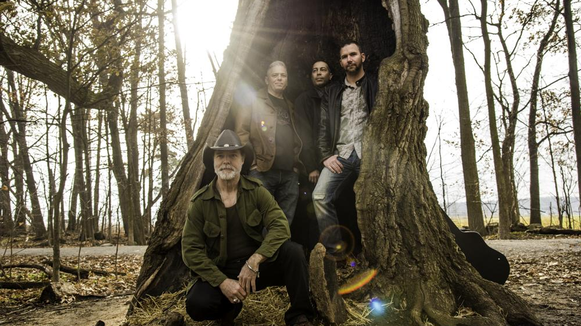

Slide 14
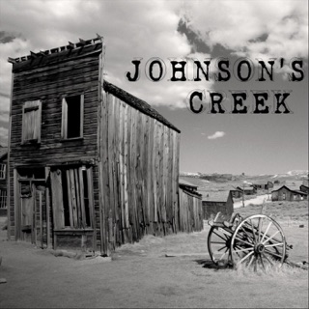
Media
- - - - X
Johnson’s Creek EP
Click to open link

Slide 15
Bookings & Contact
- - - - X
Contact Johnson's Creek Directly
Tour Dates

Slide 16
